Slide 1
vector control of ac drive using single phase asynchronous motor
Amara Dinesh Kumar
Mtech 1st Year Automotive Electronics
Amrita Vishwa Vidyapeetham
Email: cb.en.p2ael17001@cb.students.amrita.edu
Website: https://dineshresearch.github.io/
Rishish Kumar Naik
Mtech 1st Year Automotive Electronics
Amrita Vishwa Vidyapeetham
Email: cb.en.p2ael17018@cb.students.amrita.edu
Website:https://rishishkumar.github.io/

Slide 2
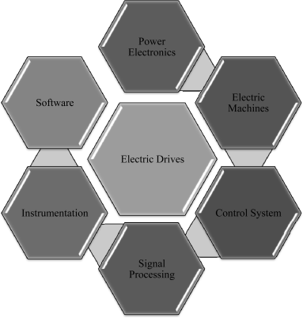
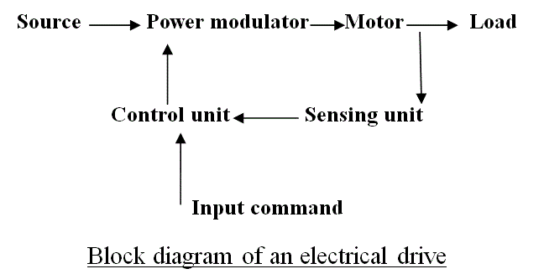
Electric Drive
The function of an electric drives system is the controlled conversion of electrical energy to a mechanical form, and vice versa, via a magnetic field.

Slide 3
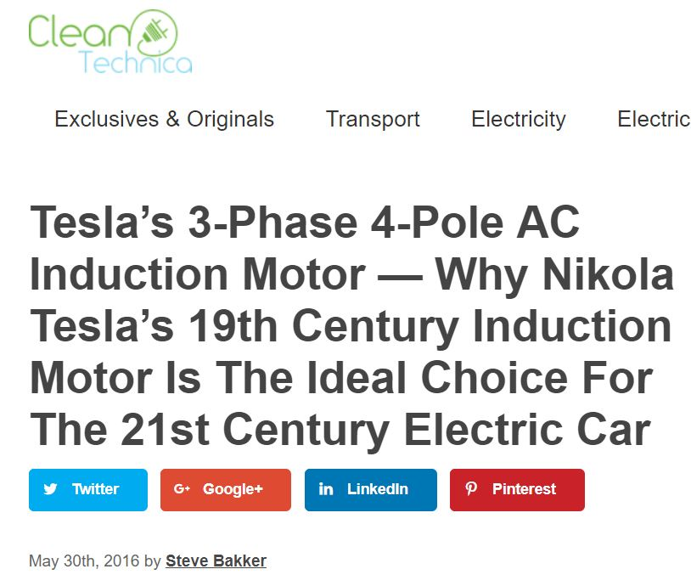
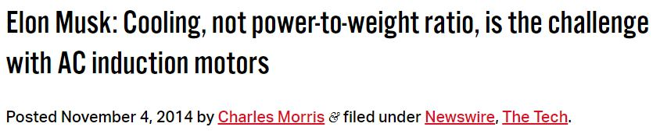


DC Drives VS AC Drives

Slide 4
Reasons behind the popularity of the Induction Motors
i. Induction Motors are cheap compared to DC Motors. In this age of competition, this is a prime requirement for any machine. Due to its economy of transportation and installation, the Induction Motor is usually the first choice for an operation.
ii. Induction Motors have high efficiency of energy conversion. Also they are very reliable
iii. Induction Motors have very high starting torque. Because of high starting torque, induction motors are useful in applications where the load is applied before starting the motor.
iv. Due to their simplicity of construction, Induction Motors have very low maintenance cost.

Slide 5
Advantages of the Induction Motor
*Speed of the motor can be controlled easily.
By varying the speed of motors depending upon the load requirements, the efficiency can be improved significantly; thus, the variable speed operation is extremely important in obtaining highly efficient operations of the machines. Controlling the operation of an electrical machine by varying its speed, in literature, is called ‘variable speed drives’ or ‘adjustable speed drives’.
Speed control is essential in Induction Motors because of the following factors:
i. It assure smooth operation.
ii. It provides torque control and acceleration control.
iii. During installation, slow running of the motors is required.
iv. Different applications require the motor to run at different speeds. All these factors present a strong case for the implementation of speed control or variable speed drives in Induction Motors.

Slide 6
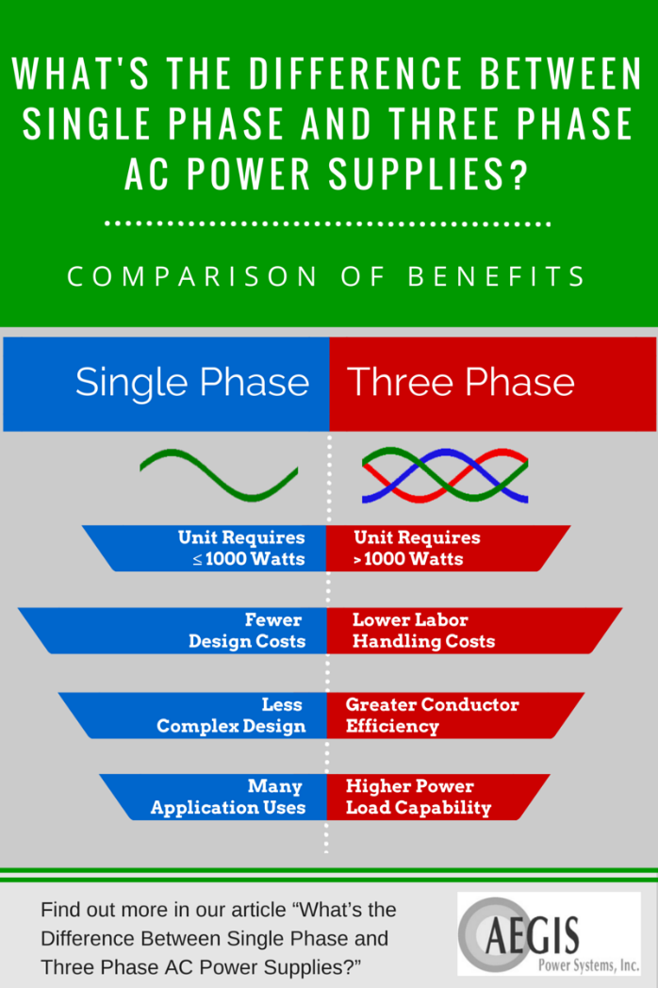

Slide 7
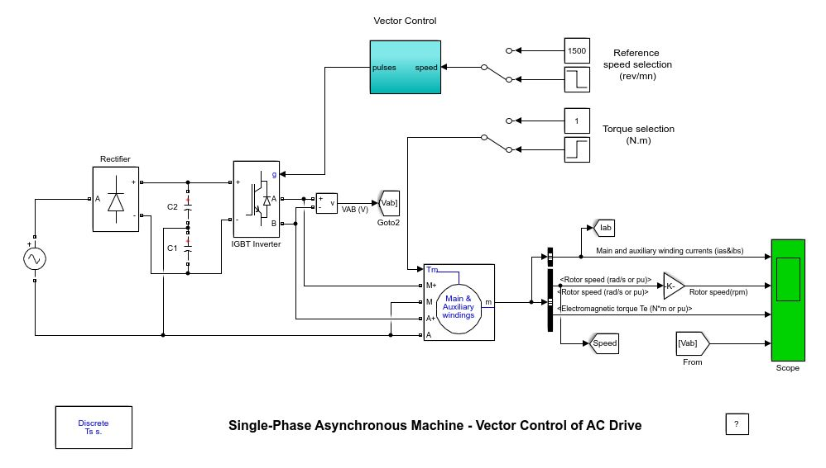
I.INTRODUCTION

Slide 8
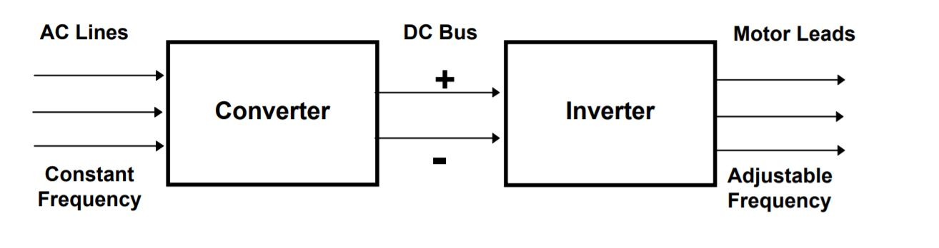
Basic Working Principle

Slide 9
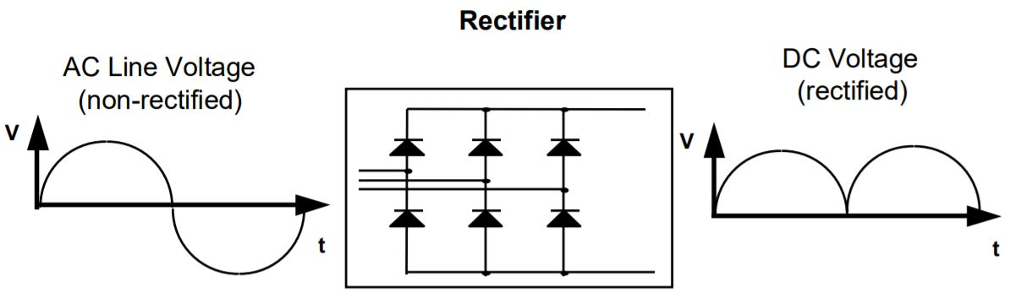
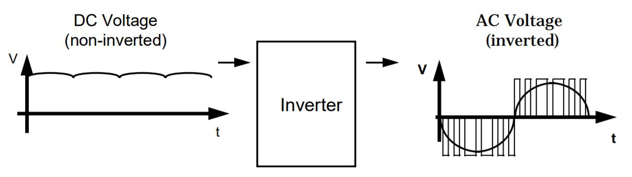

Slide 10
IGBT
An IGBT, or insulated gate bipolar transistor, is a solid state device (with no moving parts).
It is a switch that is used in order to allow power flow in the On state and to stop power flow when it is in the Off state.
An IGBT works by applying voltage to a semiconductor component, therefore changing its properties to block or create an electrical path.
The advantage gained by the insulated gate bipolar transistor device over a BJT or MOSFET is that it offers greater power gain than the standard bipolar type transistor combined with the higher voltage operation and lower input losses of the MOSFET.

Slide 11
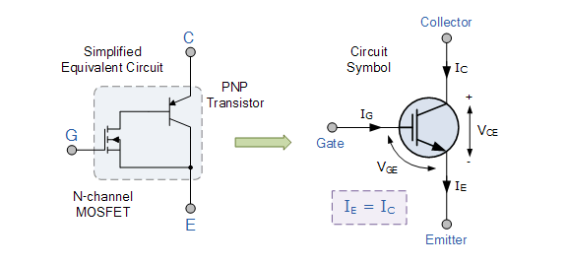
Insulated Gate Bipolar Transistor
We can see that the insulated gate bipolar transistor is a three terminal, transconductance device that combines an insulated gate N-channel MOSFET input with a PNP bipolar transistor output connected in a type of Darlington configuration.
As a result the terminals are labelled as: Collector, Emitter and Gate. Two of its terminals (C-E) are associated with the conductance path which passes current, while its third terminal (G) controls the device.

Slide 12
Advantages of IGBT
IGBTs are used in high power applications such as:
Appliance motor drives
Electric vehicle motor drives
Power factor correction converters
Uninterruptible power supplies
Solar inverters
High frequency welders
Inductive heating cookers

Slide 13
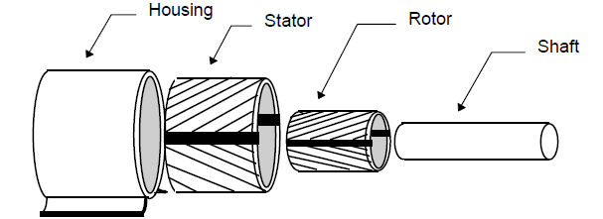
Single-phase Induction Motor
The single-phase induction motor operation can be described by Double revolving field theory.

Slide 14
Double revolving field theory
A single-phase ac current supplies the main winding that produces a pulsating magnetic field.
Mathematically, the pulsating field could be divided into two fields, which are rotating in opposite directions.
The interaction between the fields and the current induced in the rotor bars generates opposing torque.
The interaction between the fields and the current induced in the rotor bars generates opposing torque.

Slide 15
Under these conditions, with only the main field energized the motor will not start.
However, if an external torque moves the motor in any direction, the motor will begin to rotate.
The starting of the motor requires the generation of a rotating magnetic flux similar to the rotating flux in a three-phase motor.
Two perpendicular coils that have currents 90°outof-phase can generate the necessary rotating magnetic fields which start the motor.
Therefore, single-phase motors are built with two perpendicular windings.

Slide 16

The difference between the speed of the rotating stator field and the rotor speed is called slip. The smaller the slip, the closer the rotor speed approaches the stator field speed.
nsync = ns = synchronous speed in rpm
nm = mechanical shaft speed of motor
It is also possible to express the mechanical speed as :
nm = (1 - s) nsync
Synchronous speed: speed of rotating flux
Where; p = is the number of poles, and
f = the frequency of supply
% Slip = nsync – nm x 100
n_{sync}

Slide 17
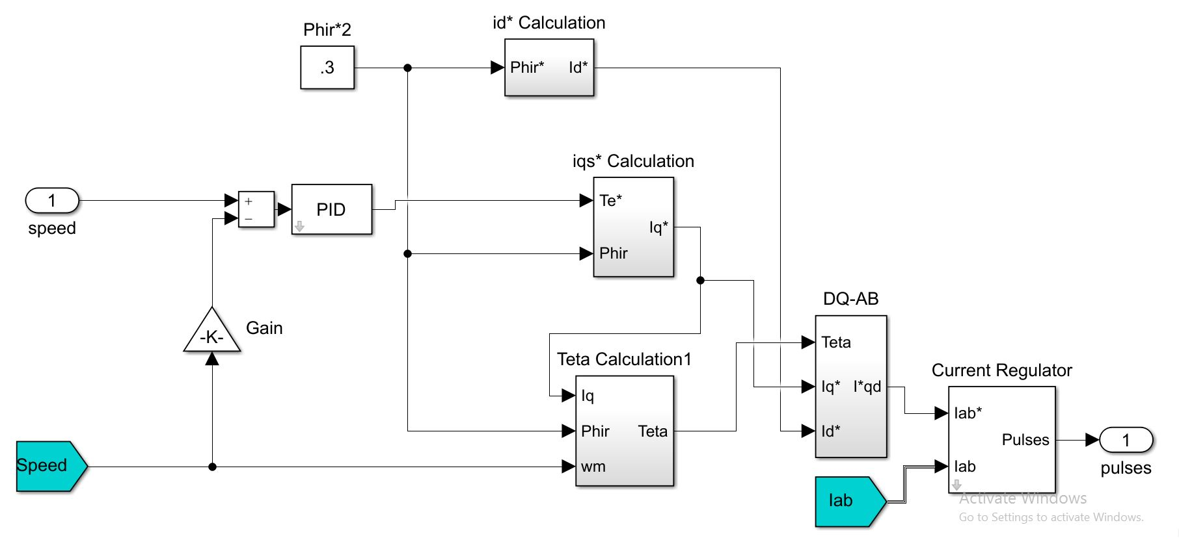
Vector control

Slide 18
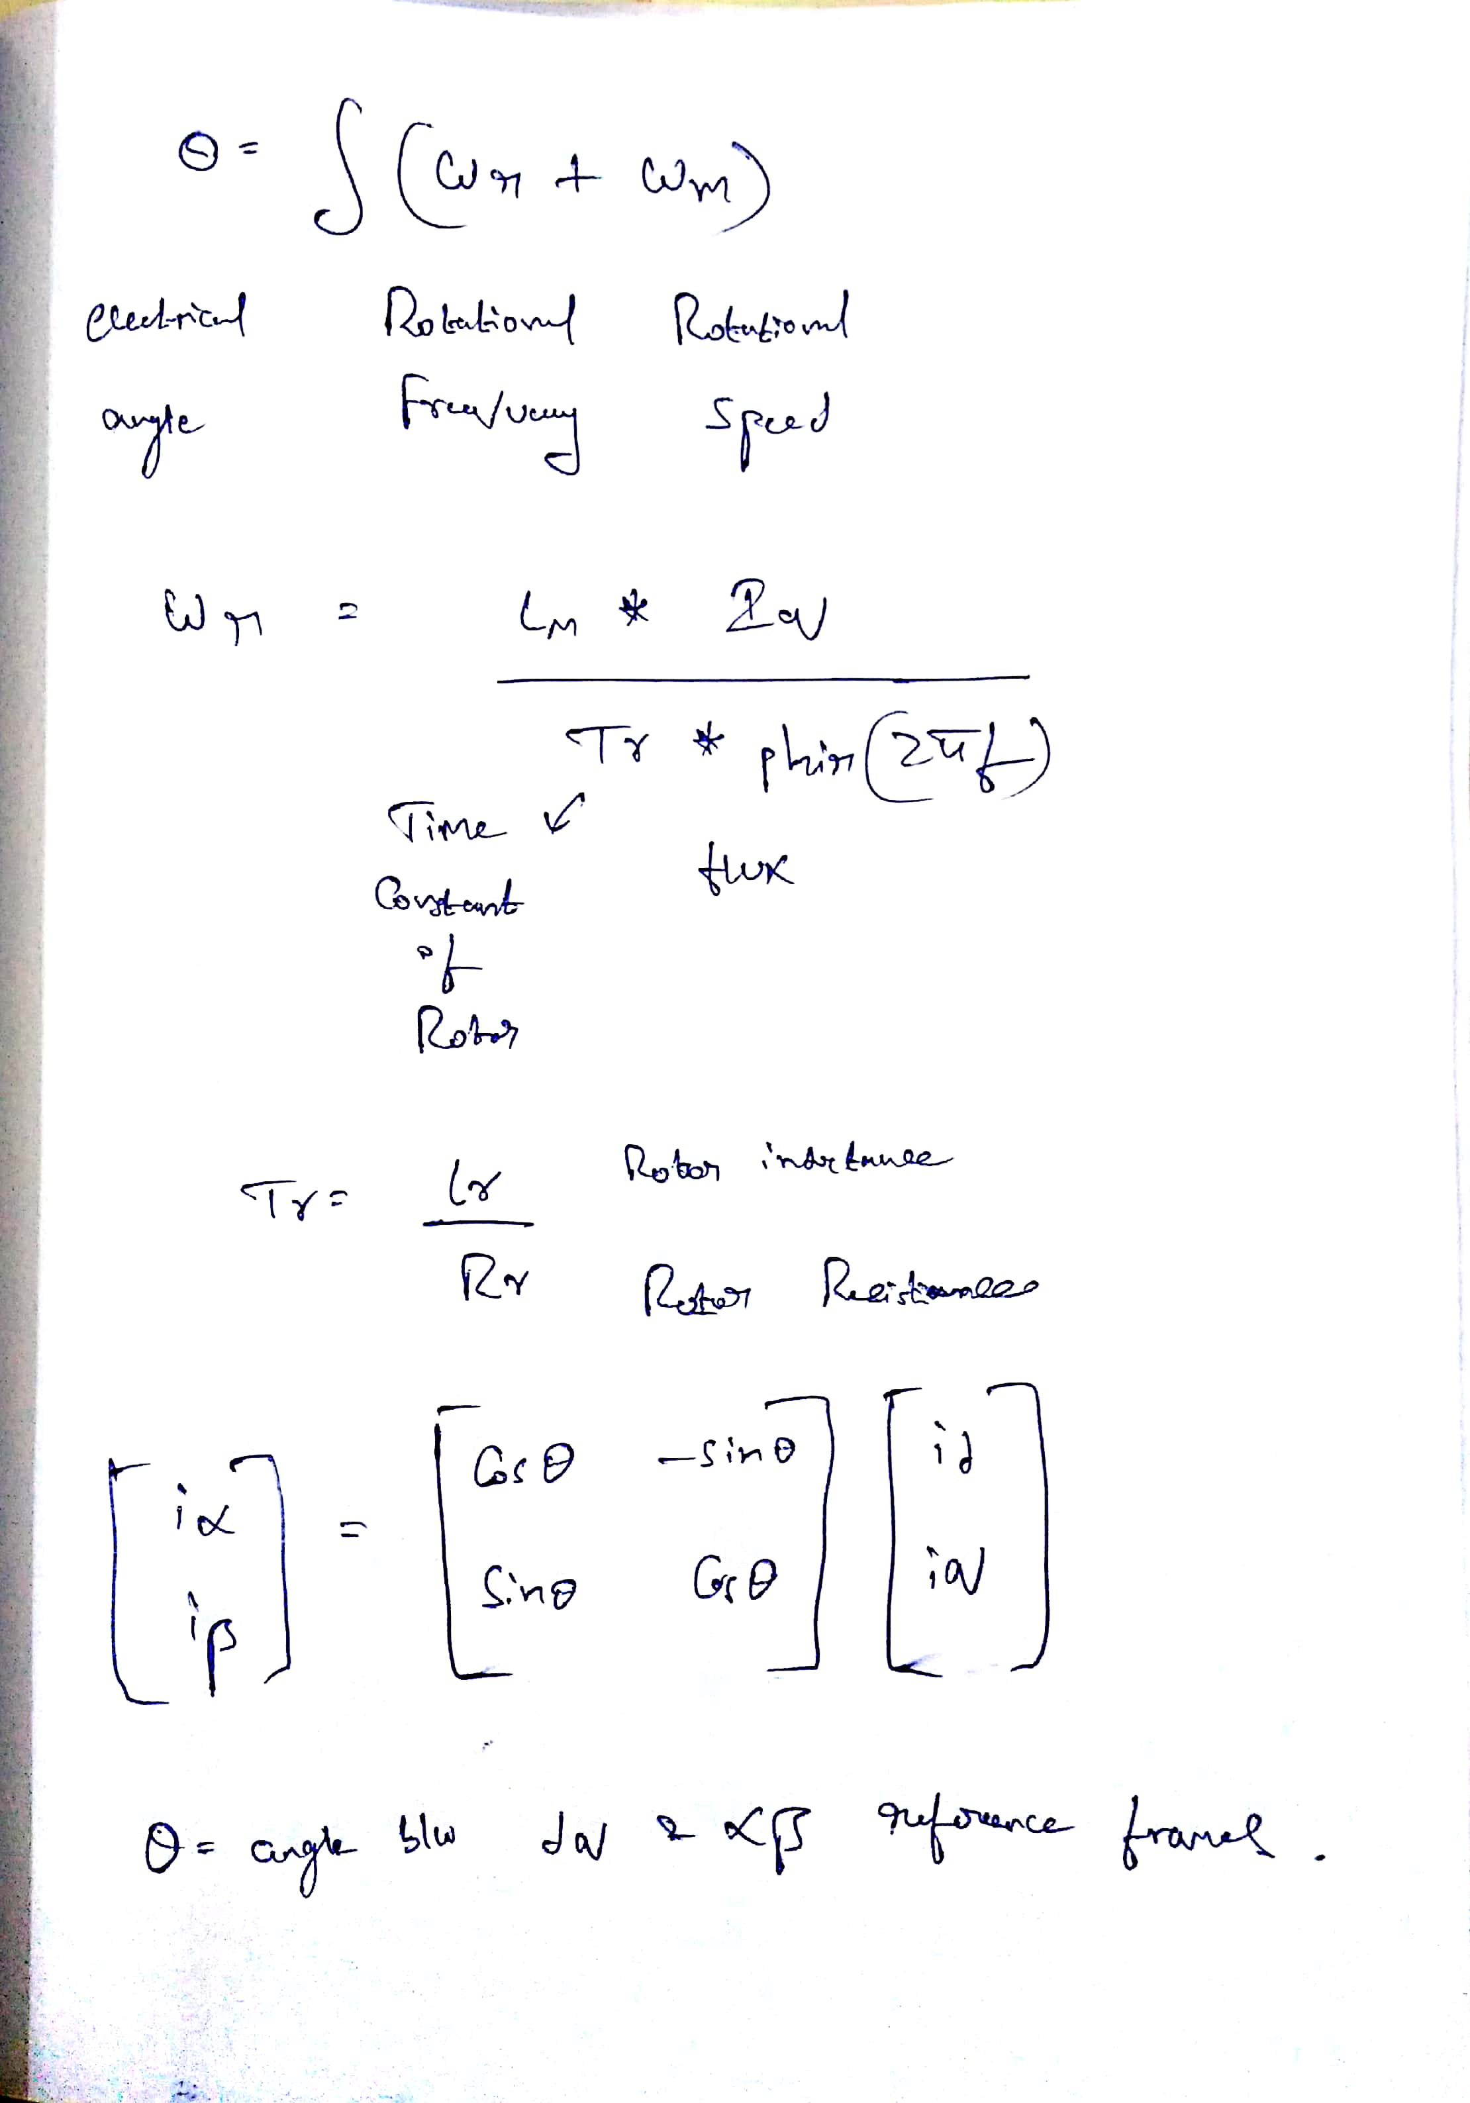
Steps involved in vector control
1.id* calculation
2.Iqs* calculation
3.Theta calculation
4.DQ-AB conversion
5.Current Regulator

Slide 19
Closed Loop Feedback by comparing the reference speed and the present motor speed.
Measurement
I Torque (constant and variable)
I Speed (constant and variable)
Input
I Torque (constant and variable)
II Speed (constant and variable)

Slide 20
Future Work
Extending vector control for implementing in 3 phase induction motor drives.
Using Extended Kalman filter in vector control which is the advanced measurement and prediction technique
These control techniques are in general called ‘high-performance drives’ as they offer extremely fast and precise dynamic and steady-state response of electric machines

Slide 21
Conclusion
Summary
A single phase asynchronous machine rated 1/4 HP, 110 V, 60Hz is fed by a current-controlled PWM inverter which is built using a Universal Bridge block. The speed control loop uses a proportional-integral-derivative regulator to produce the quadrature-axis current reference iq* which controls the motor torque.
The motor flux is controlled by the direct-axis current reference id*. The block DQ-AB is used to convert id* and iq* into current references ia*, and ib* for the current regulator. Current and Voltage Measurement blocks provide signals for visualization purpose.
Simulation
Observed on the scope the motor currents, voltage, speed, and torque during the starting. Double click on the two Manual Switch blocks to switch from the constant wref=1500 rpm and TL blocks to the Step blocks. (Reference speed wref changed from 1500 to 750 rpm at t = 2 s and load torque changed from 0 to 1 N.m at t= 1s). Restarted the simulation and observed the drive response to successive changes in speed reference and load torque.

Slide 22
REFERENCES
[1]speed control of single-phase induction motor using field oriented control,international journal of scientific & engineering research, volume 7, issue 6, june-2016
[2]speed control of induction motor without speed sensor at low speed operations,akshay prasad dubey and saravana kumar r. ,arpn journal of engineering and applied sciences,vol. 11, no. 15, august 2016
[3]j. holtz and juntao quan, "sensorless vector control of induction motors at very low speed using a nonlinear inverter model and parameter identification," in ieee transactions on industry applications, vol. 38, no. 4, pp. 1087-1095, jul/aug 2002.
[4]tung-hai chin, "approaches for vector control of induction motor without speed sensor," industrial electronics, control and instrumentation, 1994. iecon '94., 20th international conference on, bologna, 1994, pp. 1616-1620 vol.3.
[5]k. madhuri et al int. journal of engineering research and applications
speed sensorless field oriented control of induction motor through speed and flux estimation,thesis
[6]https://patents.google.com/patent/us381968a/en
Referred books
high performance control of ac drives with matlab/simulink models
vector control of induction machines desensitisation and optimisation through fuzzy logic

